Slide 1
COMP 2920 : Software Architecture & Design

Slide 2
Chapter Topics
The essentials of structural modeling.
Building blocks of structural modeling.
Basic object-oriented concepts in the context of structural modeling.
Discovering class candidates.
Elaborating and defining classes.
Relationships among classes.
Class diagrams.

Slide 3
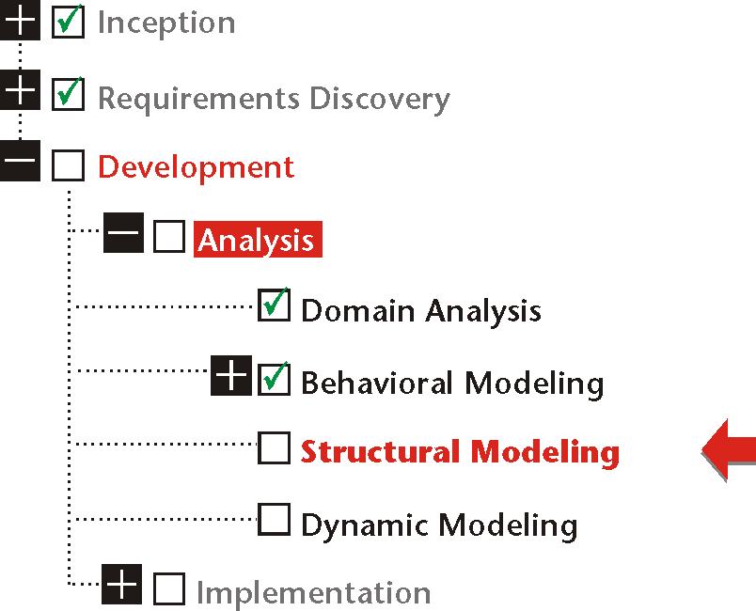

Slide 4
Building Blocks of Information Systems
An information system must have a structure that supports the system’s behavior.
The structure of an information system cannot be monolithic.
A flexible and reliable structure, therefore, needs building blocks that satisfy the specific requirements of the structure.

Slide 5
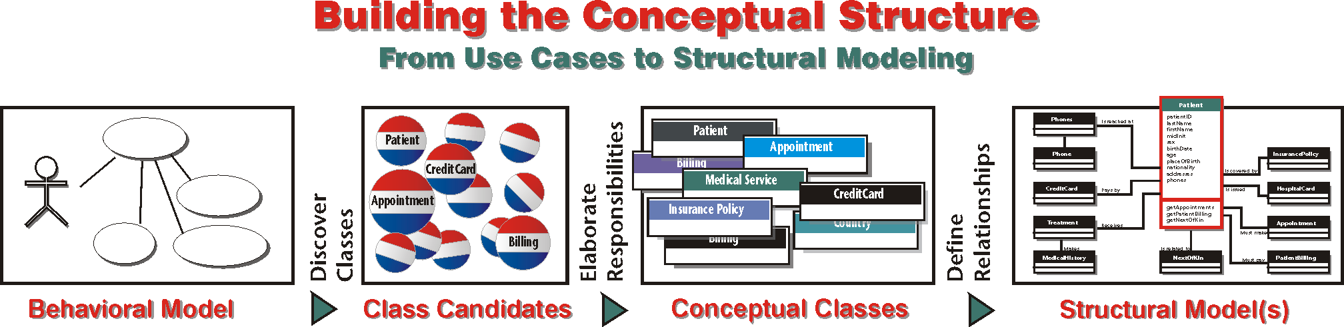

Slide 6
Structural Modeling
Structural modeling represents a view of the building blocks of a system or an entity and their interrelationships within a given scope.
Common Traits of Structural Modeling
View may be conceptual, logical or physical.
Scope can be any relevant or selected range.
A building block may be fine or coarse.

Slide 7
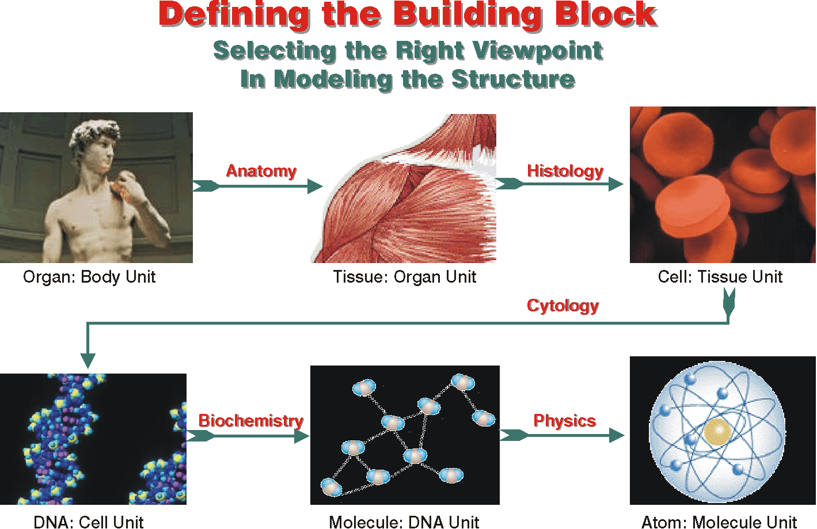

Slide 8
Classes As Object Templates
In the virtual world of software, a class is:
❶ An abstraction of objects.
❷ A template for creating objects.

Slide 9
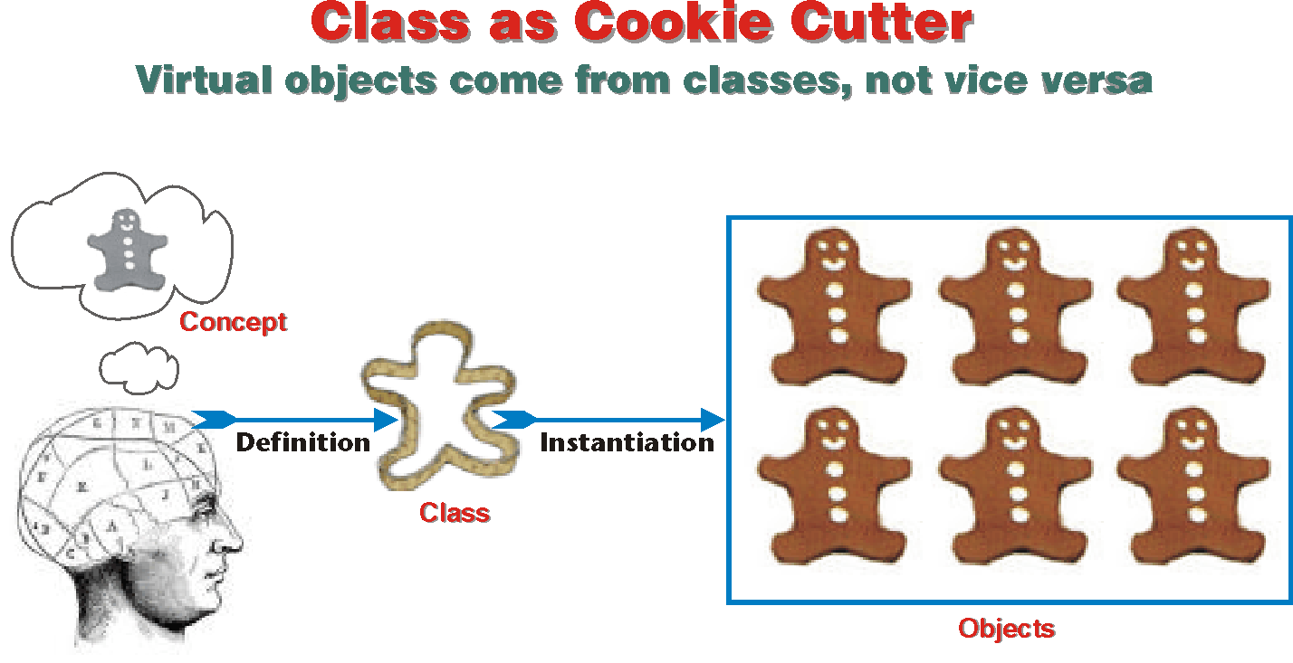

Slide 10
Classes As Building Blocks
Classes are the building blocks of structural modeling (modeling is an abstraction of reality).
Objects are the structural units of the actual information system (information system emulates reality).

Slide 11
Objects As Black Boxes
An information system object is a dynamic black box; it interacts with outside entities to provide services but conceals its inner workings.
The internal structure of an object is known only to the object itself.

Slide 12
Encapsulation
Encapsulation is enclosing data and processes within one single unit.
Encapsulation enables the object to enforce business rules with authority.
Encapsulation results in two spaces:
Private. Data and processes that are inside the object are labeled as “private.”
Public. Whatever the object exposes — that is, makes visible to the outside world — is “public.”

Slide 13
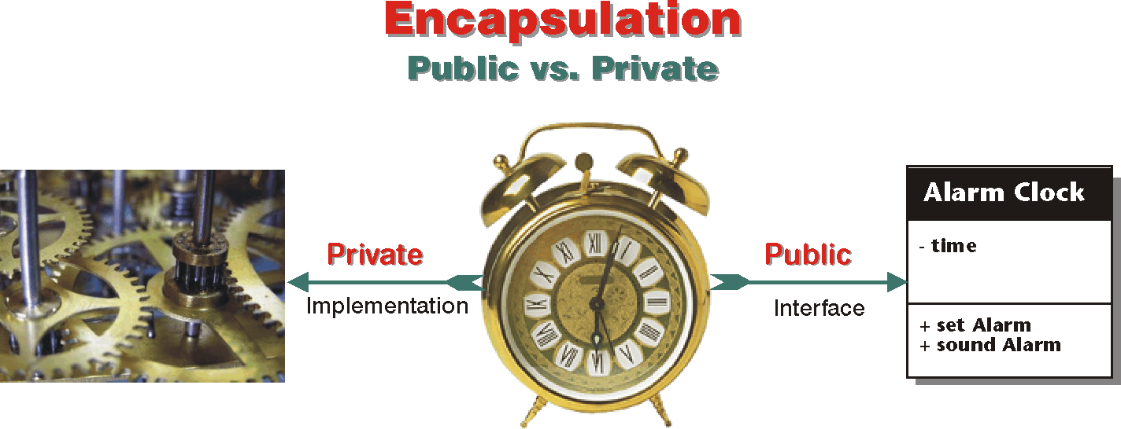

Slide 14
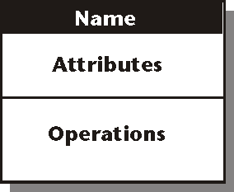
Information Hiding
Information hiding conceals the inner entities and the workings of the object from outside entities.
The box metaphor for classes and objects emphasizes: encapsulation and information hiding.

Slide 15
Interface As A Contract
An object’s interface is a contract between the object and the entities that use it.
the object promises to perform services for an outside entity that behaves according to rules that the object expects.
The interface of an object, once formalized and made available for use, cannot be changed unless all parties to the contract agree to the change.

Slide 16
Interface
The interface of an object is both the services that it offers to the outside world and how these services are structured and arranged (what you see is what you get).
The outside view of a class, object, or module, which emphasizes its abstraction while hiding its structure and the secrets of its behavior.” [Booch 1994, 515.]

Slide 17
Structuring the Interface
The interface of an object — its services — must itself be structured in a predictable manner. It has:
❶ Name
❷ Attributes
❸ Operations

Slide 18
Name
Rules and conventions that apply to naming classes:
Class name must be a noun or a noun phrase.
Class name is usually singular (except for collection class).
Class name is always capitalized.
Student, ApprovalNotice
Definite or indefinite articles must be avoided — never APatient

Slide 19
Attribute
Attribute is what an object knows.
Class attributes are placeholders: it is the objects that fill the placeholders — or variables — with values.
Attribute names begin with a lower-case letter; firstName.
The lower-case start is a convention to distinguish attributes and operations from classes.

Slide 20
Operation
Operation defines what an object does or what can be done to it
A class merely defines what an object is expected to do.
It is the object that carries out the actual operation: a Plane class does not fly; a plane object does
Rules for naming operations are the same as for naming attributes.
move (verb)
getStarted (verb)

Slide 21
Visibility
The visibility of an object’s attributes or operations defines their availability to other objects.

Slide 22
Symbols for Visibility
Symbol | Visibility | Description
+ | Public | The attribute or operation is visible to all entities.
- | Private | The attribute or operation is private and cannot be (directly) accessed by outside entities.
# | Protected | The attribute or operation is available only to the object or its descendants. (See chapter 15, Components & Reuse.)
~ | Package (Friend) | Only other objects in the package (or component) can use the attribute.

Slide 23
Composite and Collection Objects
A composite object is one that is composed of other objects.
A collection object is a composite object that manages a set of objects instantiated from the same class.

Slide 24
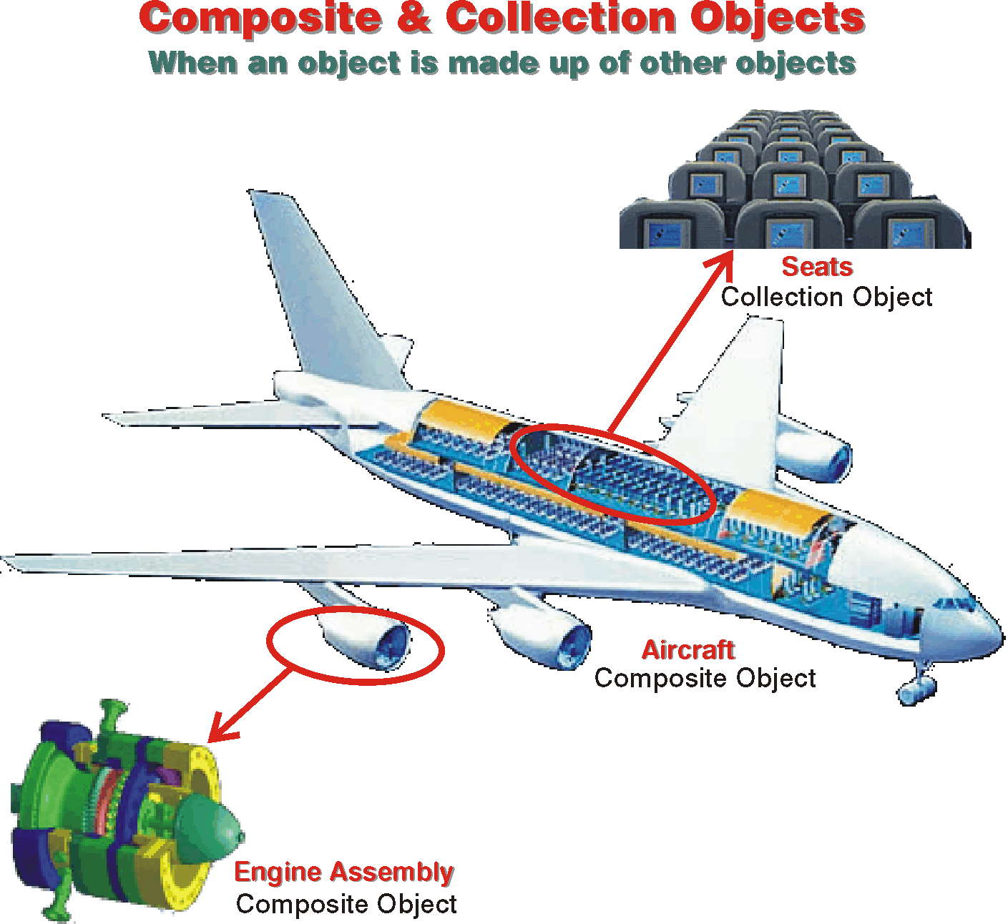

Slide 25
Finding Classes
To discover business objects, we must start by mining the flow of use cases.
The messages exchanged between the actors and the system refer to objects that are affected by the interaction between the two:
by parsing the messages that the steps in a use case scenario specify, we can start the discovery of classes.

Slide 26
Responsibilities
An object’s responsibilities consist of what it does and what it knows; in other words, its operations and its attributes.
Before we can define classes in detail, we must discover class candidates and outline their tentative responsibilities.

Slide 27
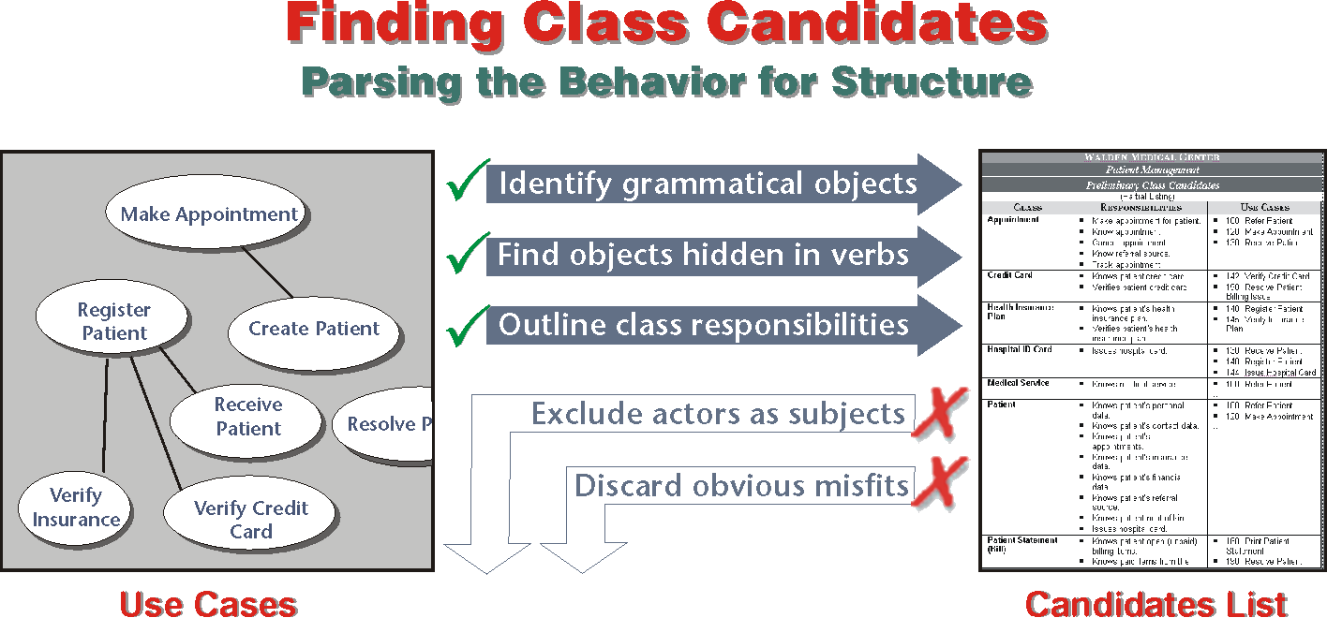

Slide 28
Finding Class Candidates
Make Appointment | Normal Flow: | 1. Appointment clerk verifies that the needed medical service is provided by the hospital. 2. Appointment clerk records patient’s personal and contact data. 3. Appointment clerk records information about the referral source. 4. Appointment clerk consults hospital’s schedule to find a free slot for the required medical service. 5. Appointment clerk verifies that the patient is available for the appointment. ➔ Loop 1: Repeat steps 4-5 until hospital’s schedule matches patient’s availability. 6. Appointment clerk makes the appointment. ➔ Loop 2: Repeat steps 4-6 for each appointment.

Slide 29
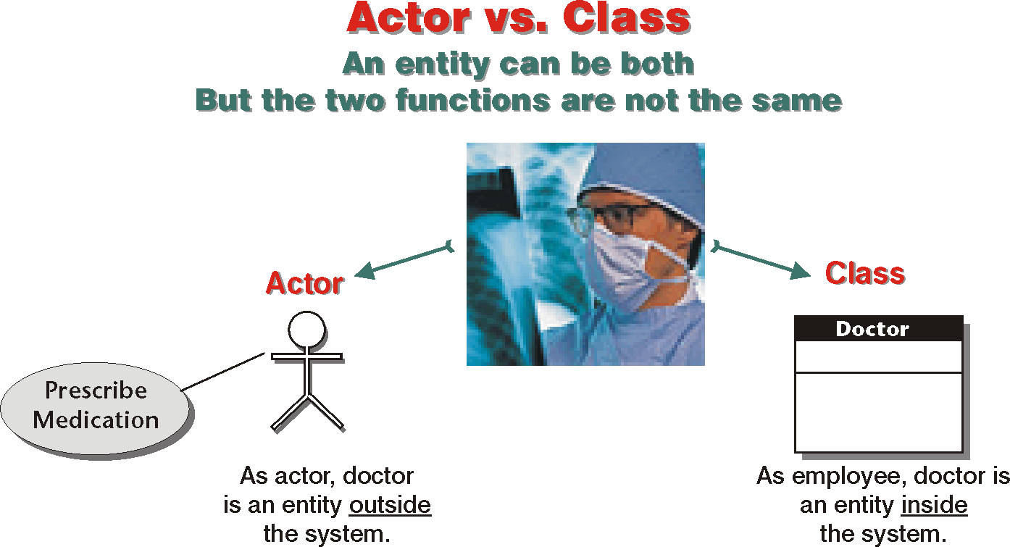

Slide 30
Patient Management: Preliminary Class Candidates
Class | Responsibilities | Use Cases
Appointment | Make appointment for patient. Know appointment. Cancel appointment. Know referral source. Track appointment. | 100: Refer Patient 120: Make Appointment 130: Receive Patient
Credit Card | Knows patient credit card. Verifies patient credit card. | 142: Verify Credit Card 190: Resolve Patient Billing Issue
Health Insurance Plan | Knows patient’s health insurance plan. Verifies patient’s health insurance plan. | 140: Register Patient 145: Verify Insurance Plan
Hospital ID Card | Issues hospital card. | 130: Receive Patient 140: Register Patient 144: Issue Hospital Card
Medical Service | Knows medical service. | 100: Refer Patient …
Patient | Knows patient’s personal data. Knows patient’s contact data. Knows patient’s appointments. Knows patient’s insurance data. Knows patient’s financial data. Knows patient’s referral source. Knows patient next of kin. Issues hospital card. | 100: Refer Patient 120: Make Appointment …
Patient Statement (Bill) | Knows patient open (unpaid) billing items. Knows paid items from the last statement. Prints billing statement. | 160: Print Patient Statement 190: Resolve Patient Billing Issue
Payment | Knows the payment credited to patient’s account. | 190: Resolve Patient Billing Issue
Referral Source | Knows the referral source. | 120: Make Appointment
Hospital Schedule | Knows appointments. Knows openings for medical services. | 120: Make Appointment

Slide 31
Elaborating Classes
To fully define a class or an object is to define responsibilities in detail.
Patient class has a number of obligations:
Knows patient’s personal data.
Knows patient’s contact data.
Knows patient’s appointments.
Knows patient’s insurance data.
Knows patient’s financial data.
Knows patient’s referral source.
Knows patient’s medical history.
Knows patient’s next of kin.
Issues hospital card.

Slide 32
Delegating Responsibilities
An object can delegate responsibilities to objects that collaborate with it.
“If the type [of an attribute] has a complex data structure, we often have to make a new class of the attribute type … ”

Slide 33
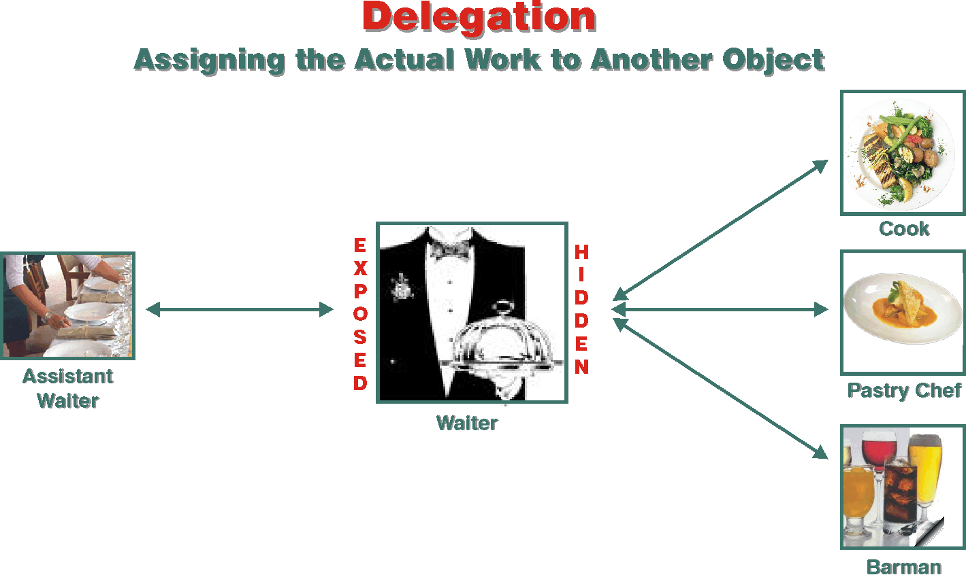

Slide 34
Collaboration
Attribute | Collaborators
patientID
lastName
firstName
midInit
sex
birthDate
age
placeOfBirth
nationality | Country
addresses | Address Addresses
phones | Phone Phones
insurancePolicy | InsurancePolicy
creditCard | CreditCard
validCardID | HospitalCard
medicalHistory | Treatment MedicalHistory

Slide 35
Operations
Operation | Collaborators
getAppointments | Appointment
getPatientBilling | PatientBilling
getNextOfKin | NextOfKin

Slide 36
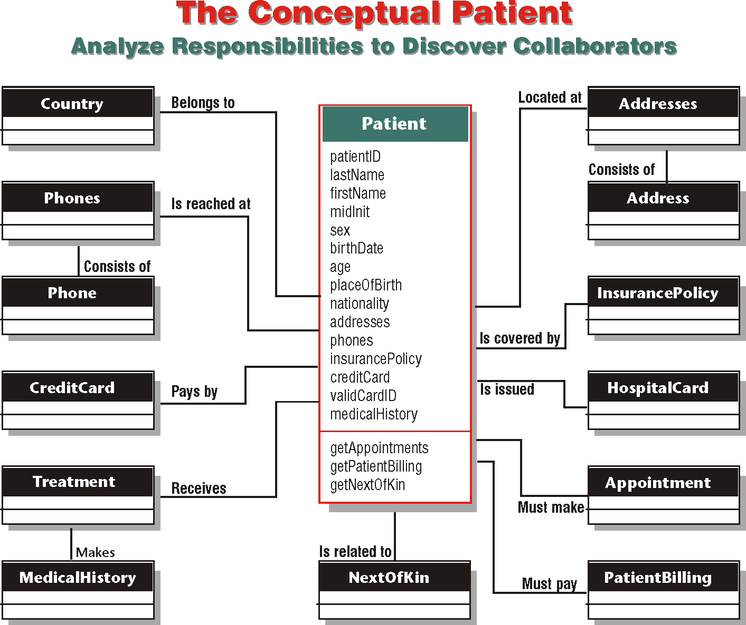

Slide 37
Relationships
Association
Aggregation
Composition

Slide 38
Association
Association is a structural relationship that defines the link between objects of one class with the objects of another class

Slide 39
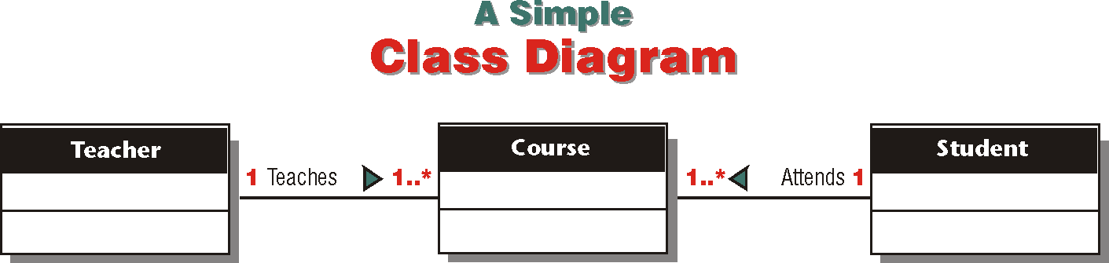
Class Diagram
Class diagram shows a set of classes and their interrelationships.

Slide 40
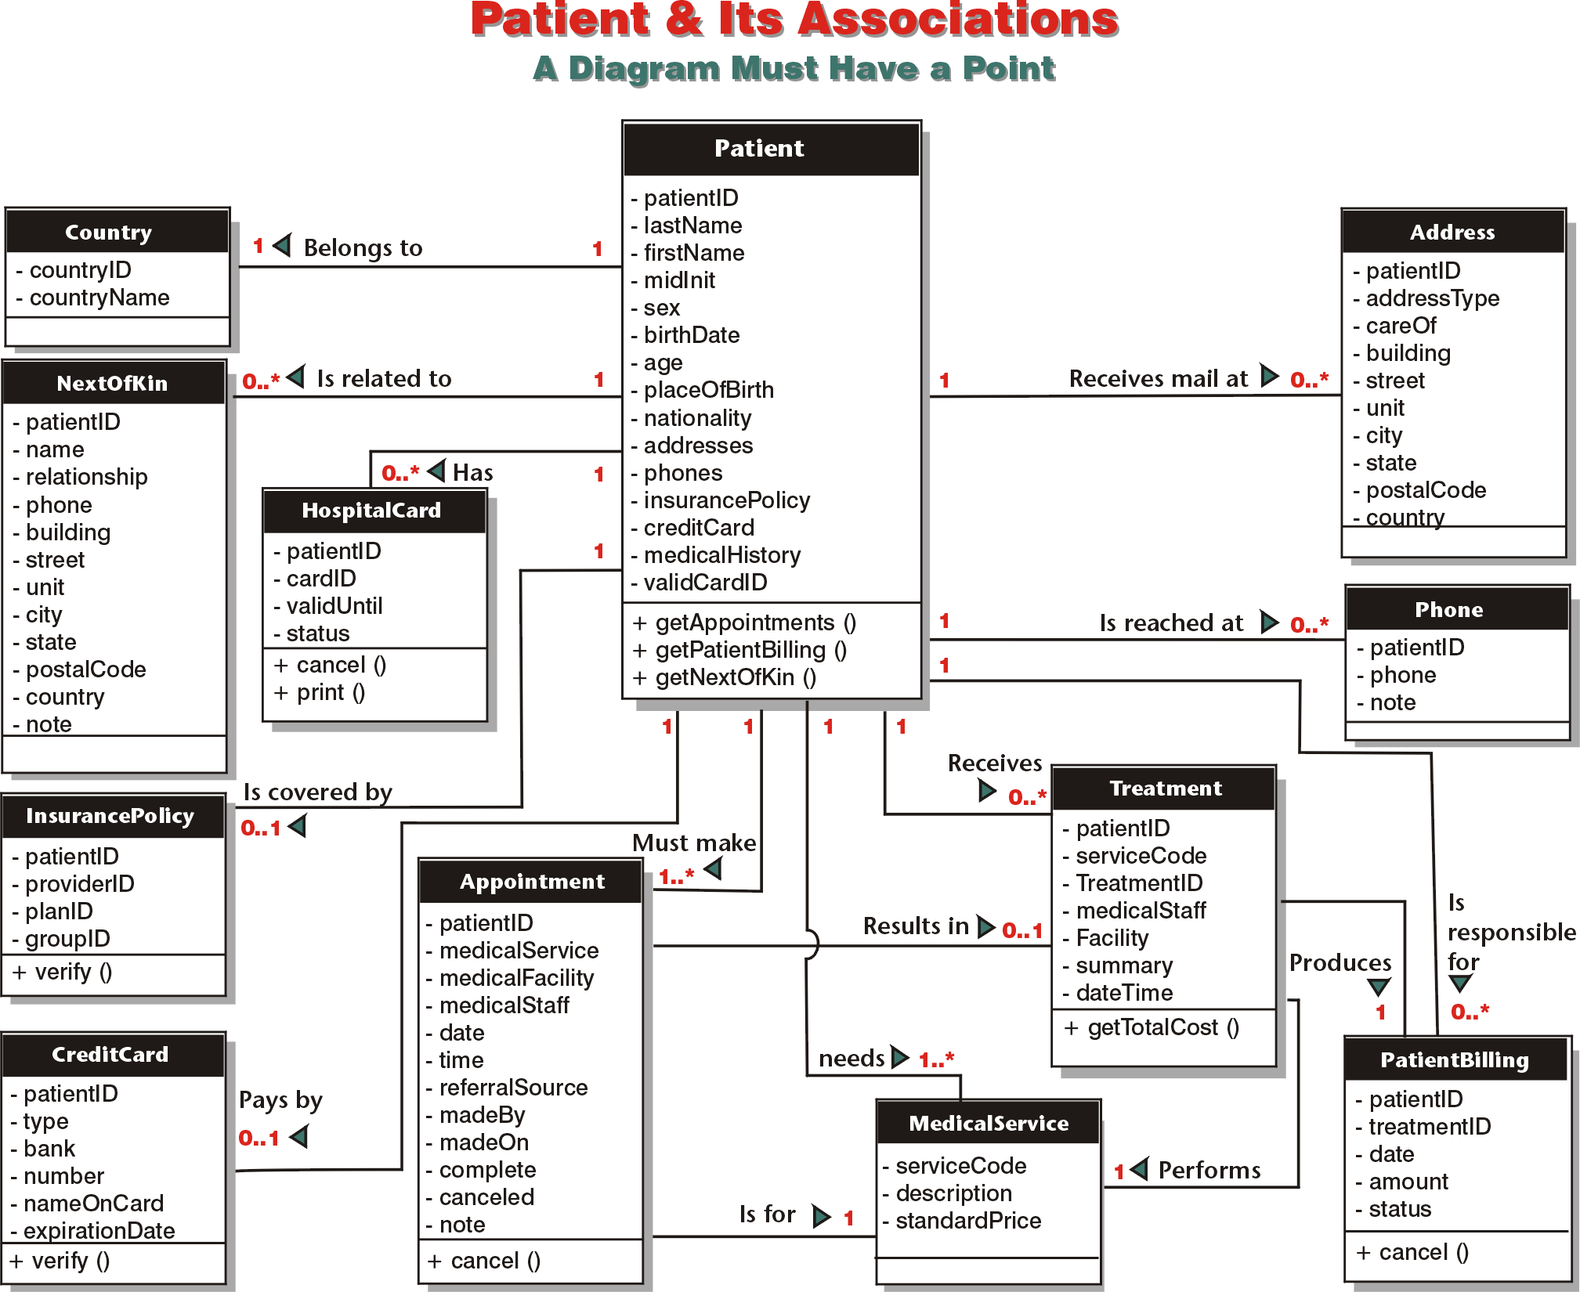

Slide 41
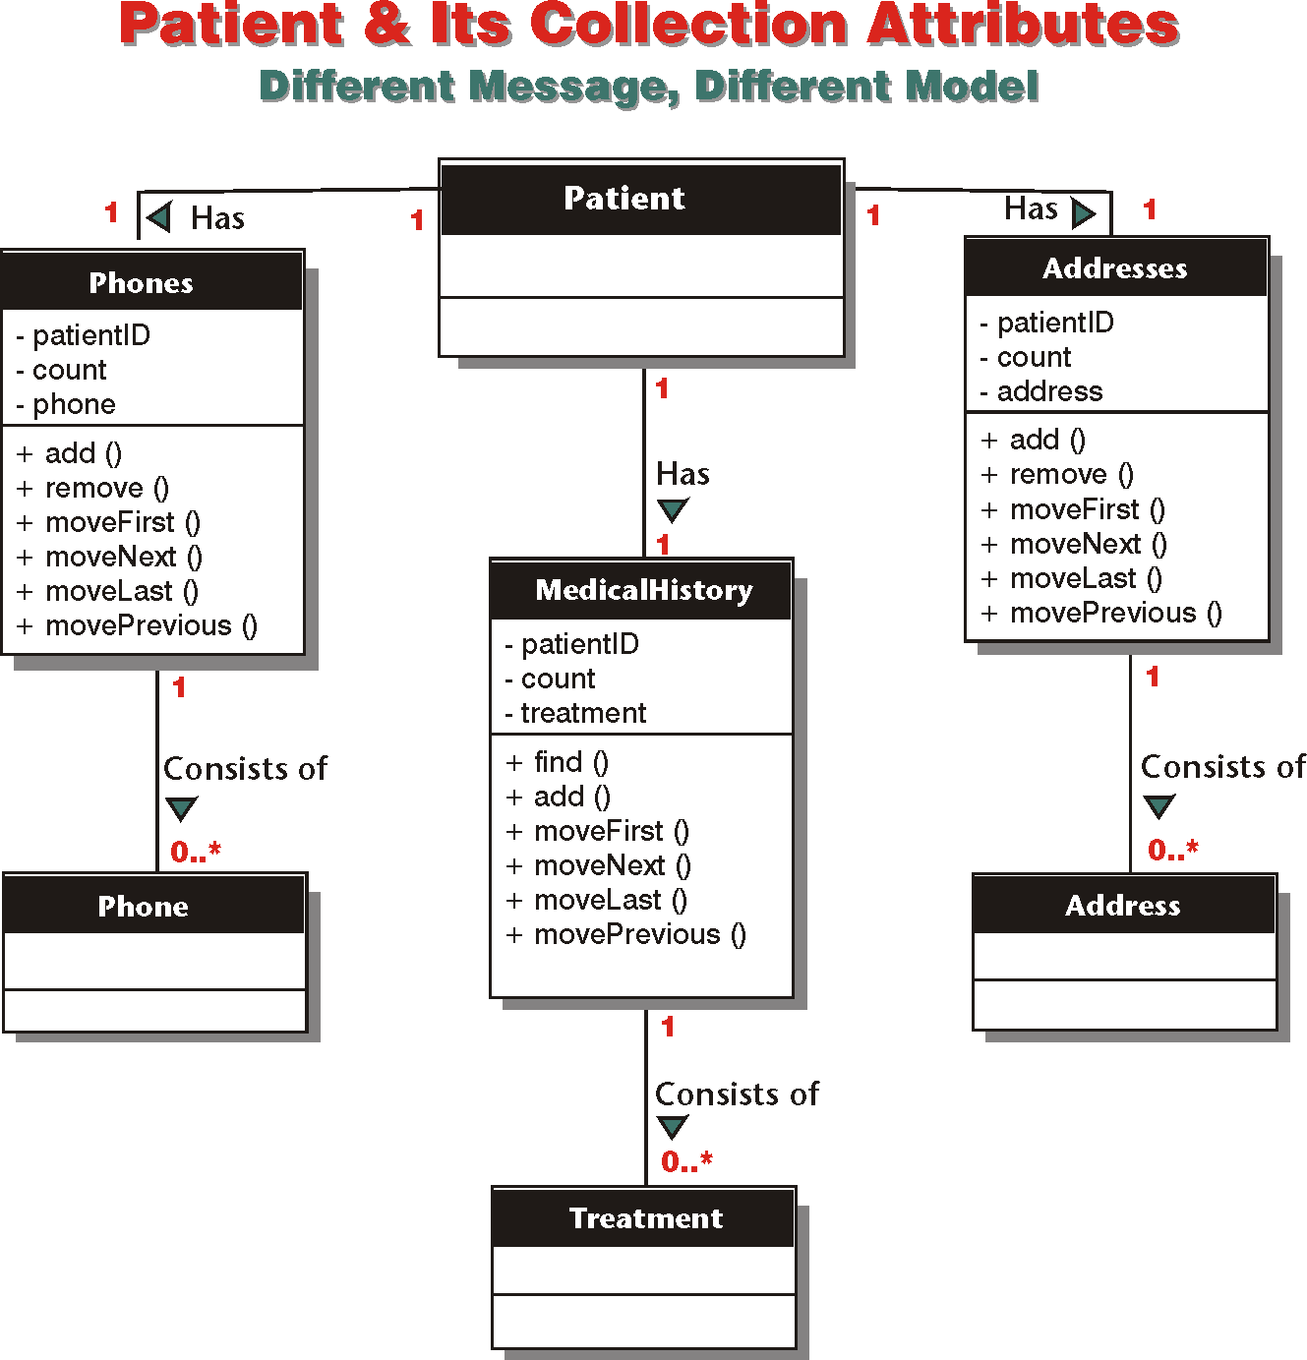

Slide 42
Multiplicity
Multiplicity specifies how many instances of one class can associate with instances of another class.

Slide 43
Multiplicity
Multiplicity | Meaning | Example
1 | Exactly one | A patient must have one, and only one, nationality.
0..1 | Zero or one | A patient can have no insurance plan or can have one.
1..* | One or more | A patient must have at least one appointment to receive medical service, but can have as many as necessary.
0..* | Zero or more | A patient can have no billing activity or many.
20..40 | A defined range | A part-time worker must work at least twenty hours a week, but no more than forty.
2,4, 6, 8 | A non-continuant range | Tables are set for 2, 4, 6, or 8 people.

Slide 44
Aggregation and Composition
Aggregation represents the relationship of a whole to a part. Composition is a form of aggregation in which the part is exclusively owned by the whole and its lifecycle is dependent on the lifecycle of the whole.

Slide 45
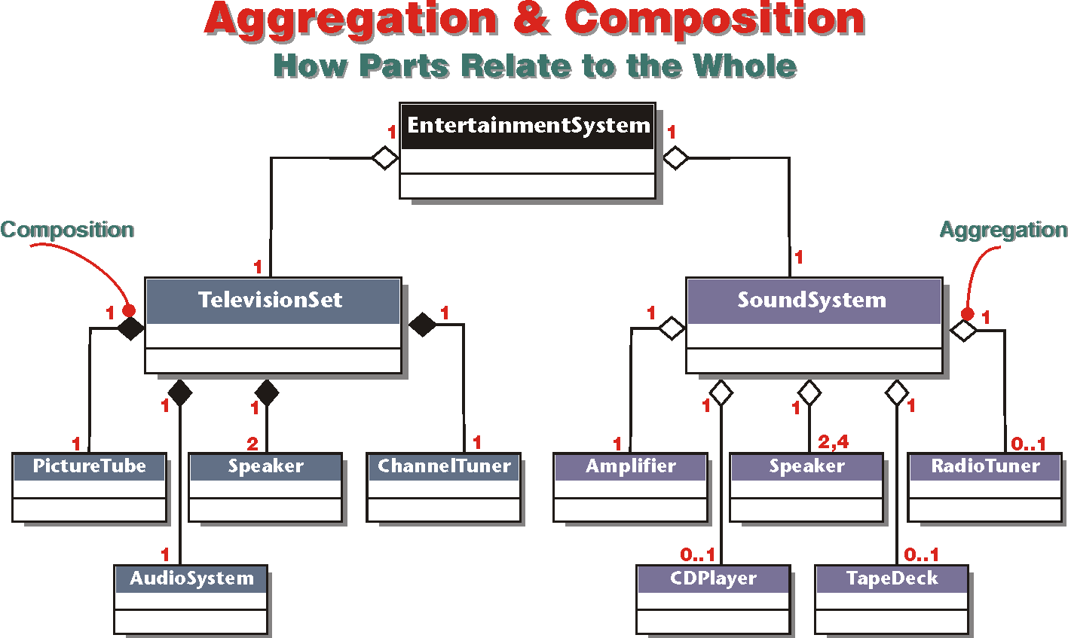

Slide 46
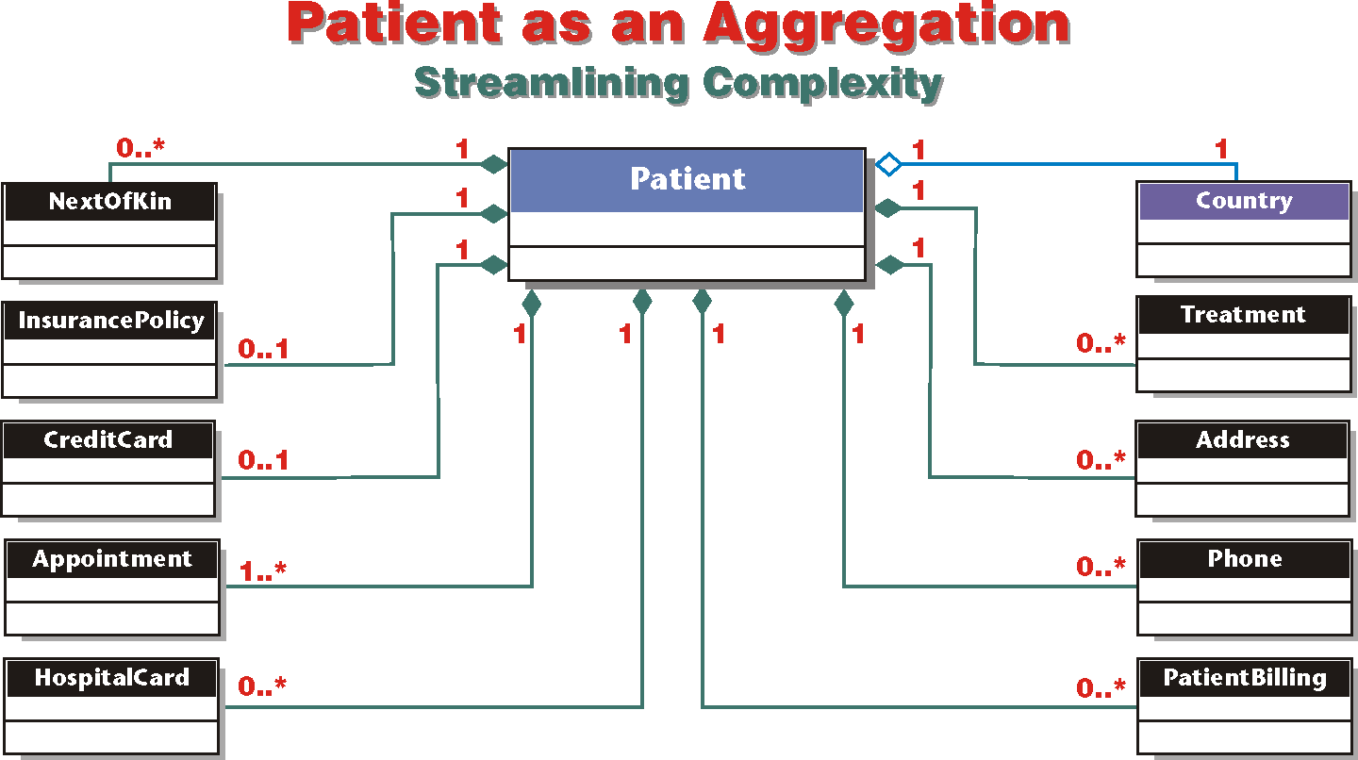

Slide 47
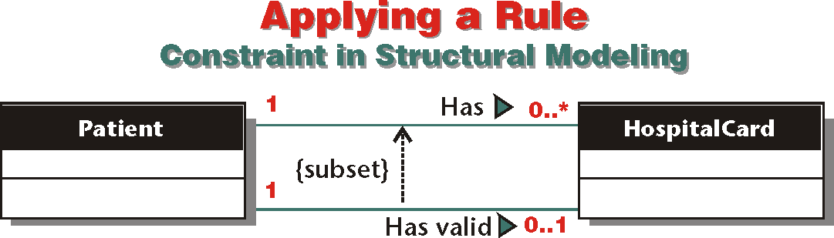
Constraints
In structural modeling, constraints are rules that apply to associations.

Slide 48
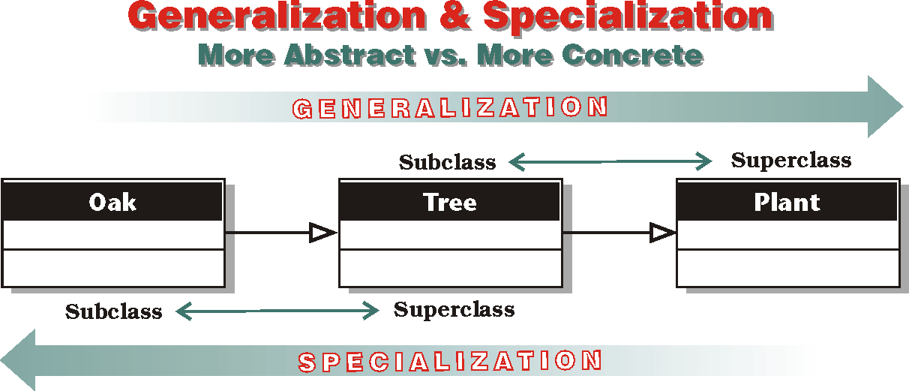

Slide 49
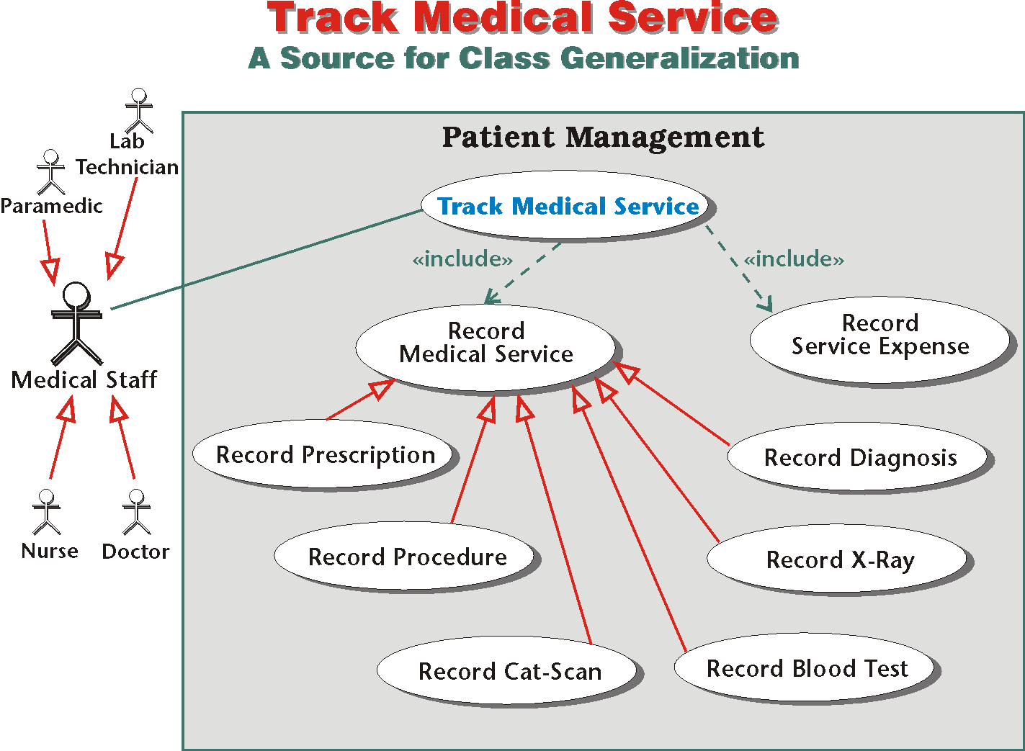

Slide 50
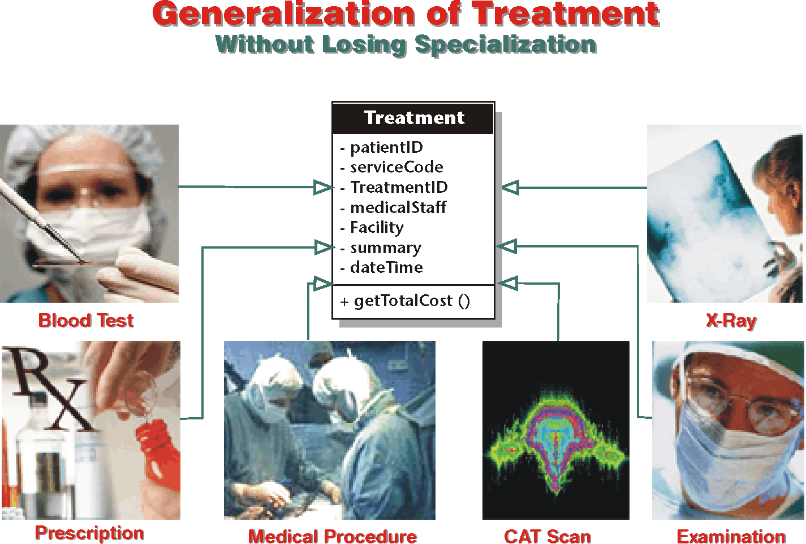

Slide 51
Next: Dynamic Modeling
Dynamic modeling represents how the identifiable units of the structure interact with each other and with the outside world and the changes that result from the interactions.

